Slide 1
Resume Review and Interview Preparation
Shannon Krantz
Talent Acquisition – Campus, Diversity, Military

Slide 2
Learning Objectives
As you are completing practical work experience through the ODxOS program, you will want to find a job opportunity to match your skills, submit your resume and application to entice the recruiter to want to schedule an interview, and finally interview well to secure your DREAM position.
Resume Review
How to Prepare for an Interview
Clear contact information
List all education and work experience in chronological order
Emphasize technical skills and soft skills, both are needed for technical roles
Your resume is like a quick book summary, give them just enough information to want to learn more
Recognize the different types of interview questions and strategies for answering them effectively
Understand how to analyze a job description to identify interview talking points
Understand how to market your individual/unique strengths for an interview
Develop insightful questions to ask at the conclusion of an interview

Slide 3
Resume Review

Slide 4
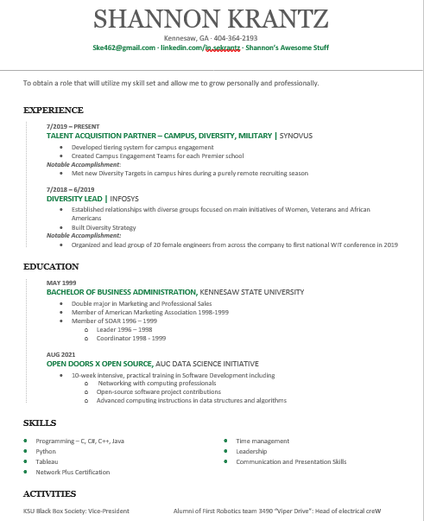
Resume Sample
Your resume should:
Be easy to read and follow
Be succinct and to the point
Be one page, two at the most
Include the following:
Contact Information
Relevant Experience
Education
Additional Skills
Metrics of performance
Key words

Slide 5

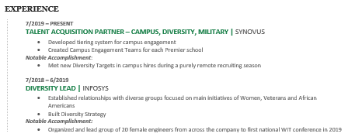
Resume Breakdown
1. Contact Information
Name
Address – you can or cannot
Phone
Email
2. Experience listed in CHRONOLOGICAL ORDER
Company Name and Location
Title
Time Frame worked
2-3 Bullets of responsibilities
1-2 Bullets of Key Accomplishments

Slide 6
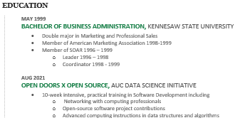
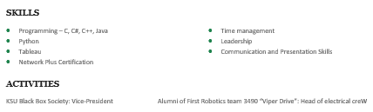
Resume Breakdown
3. Education
School Name
Degree
Major
Graduation Date – you can or cannot
Include any additional educational programs
4. Additional Information
Technical
Soft

Slide 7
Interview Preparation

Slide 8
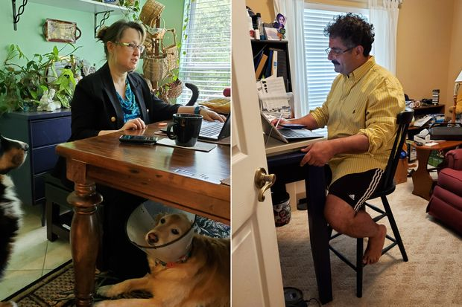

In-Person vs. Virtual/Video Interviews
In the time of this pandemic, many employers have begun to utilize virtual/video interviews. How does this differ from an in-person interview? How are in-person and video/virtual interviews the same? What can you do to make yourself stand out virtually?
In-Person Interview
Virtual/Video Interview
Dress professionally/appropriately for position
Be early to interview, at least 5-10 minutes
Have multiple copies of resumes
Body language during interview
Dress professionally/appropriately for position
Be early to interview, at least 3-5 minutes
Virtual etiquette

Slide 9

Interview Questions
Skills based
Technical skills
Academic
Real-world
Behavioral
Strengths
Weaknesses
Soft skills
Situational
Examples of how you handled a certain type of situation
Notes:
There are all different types of questions recruiters and interviewers can ask. Online you find categories of each kind – credential, experience, opinion, behavioral, brainteaser, nonsense or stupid questions
Good interviews will ask questions to discover certain characteristics about you. Mainly, they will stick to three topics, skills-based, behavioral and situational.
Skills based focuses on your technical skills and what you have learned in the class room vs in a real world work place environment.
Behavioral focuses on your strengths, weaknesses and other soft skills
Situational questions are looking for examples of how you handled certain situations, for instance in for a sales role, a question could be along the lines of give me an example of a time when you had to deal with a difficult customer, how did you handle it and what was the outcome.

Slide 10
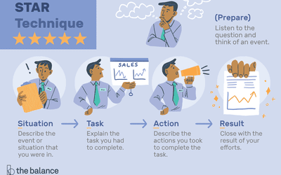
Interview Preparation
Notes:
Best way to answer most questions, especially situational questions is using the STAR technique. It is okay to take a minute to think of the best response or event to explain.

Slide 11
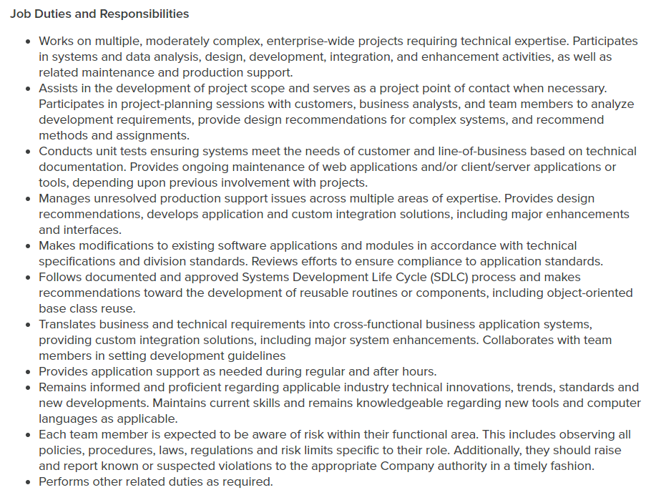
Analyze Job Description for Talking Points
Notes:
First of all, no one will ever tell you not that you cannot take notes during an interview. So it is fine for you have some notes jotted down in the event your questions are not answered. Most of the time, any questions you have about the job should be covered in the 1st or 2nd interview. But you always want to review the JD before you walk into the interview, just in case they ask you something specific about it.

Slide 12
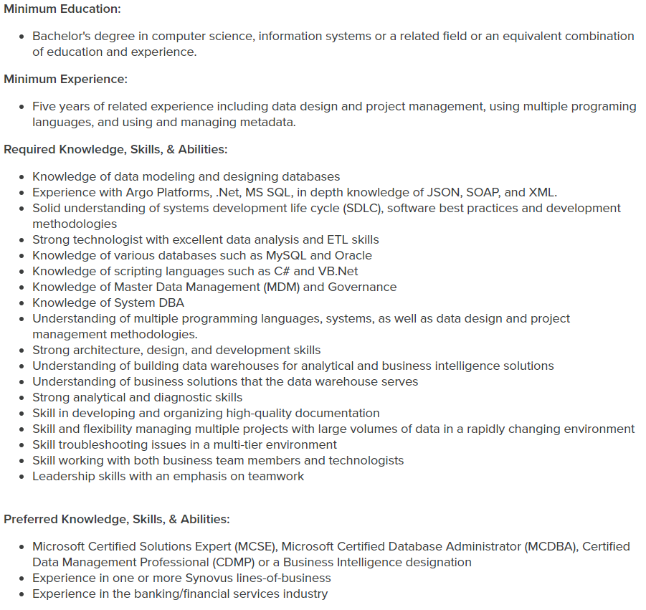
Analyze Job Description for Talking Points
Notes:
First of all, no one will ever tell you not that you cannot take notes during an interview. So it is fine for you have some notes jotted down in the event your questions are not answered. Most of the time, any questions you have about the job should be covered in the 1st or 2nd interview. But you always want to review the JD before you walk into the interview, just in case they ask you something specific about it.

Slide 13

Market Your Strengths
Elevator pitch
Know your strengths
Know your weaknesses
Practice, practice, practice
Notes:
Who has a good elevator pitch?
Understand your strengths and weaknesses again – as you talk through the interview, utilize your strengths to the fullest.
Practice what you want to say about yourself, talk to yourself in the mirror, in the car.

Slide 14

Conclusion of the Interview
Opportunity to ask questions
Current and future projects
Growth opportunities
Ask for business card or contact information
Thank interviewer
Thank reception (if in-person)
Notes:
After your interviewer is finished assessing you, he/she will ask if you have any questions. This is a great way to showcase some of your knowledge of the company and/or position in an intelligent way. I caution you tho, don’t ask stupid questions or questions that will make the interviewer feel dumb. I can’t put it more bluntly than that.
Ex: timeline question – dumb; decision date question – fine
Don’t forget to thank them!
Ask for a card so you can send a follow-up thank you email or hand written note
Thank reception! – very important, they may be asked how you treated them

Slide 15
Current Job Openings
IT Developer I, II, or SR
Application Engineer I, II or SR
IT Security Engineer
ETL Developer Sr.
Find these and more at https://careers.synovus.com/

Slide 16



Follow Us
@synovus
@synovuscareers
@synovuscareers
#yourfuturehere

Slide 17

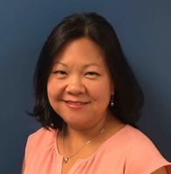
Shannon Krantz
Talent Acquisition – Campus/Diversity/Military
3400 Overton Park Dr SE, 4th Floor, Atlanta, GA 30339
P: 404-364-2193
E: shannonkrantz@synovus.com

